Slide 1
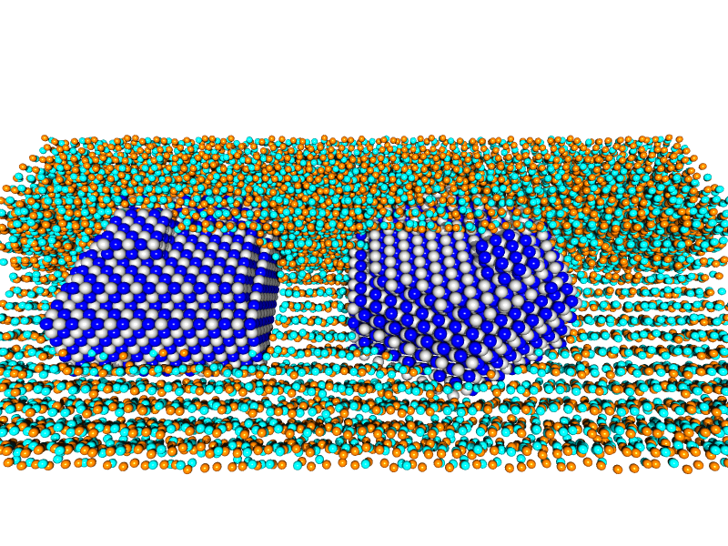
TiN(001) & TiN(111) in a-SiN
Colors correspond to atomic species: blue and cyan to N, grey to Ti, and orange to Si. The amorphous SiN layer has been generated by randomly perturbing a hexagonal lattice. Channeling is present in the amorphous layer, indicating that a larger perturbation is needed to approximate realistic a-SiN.

Slide 2
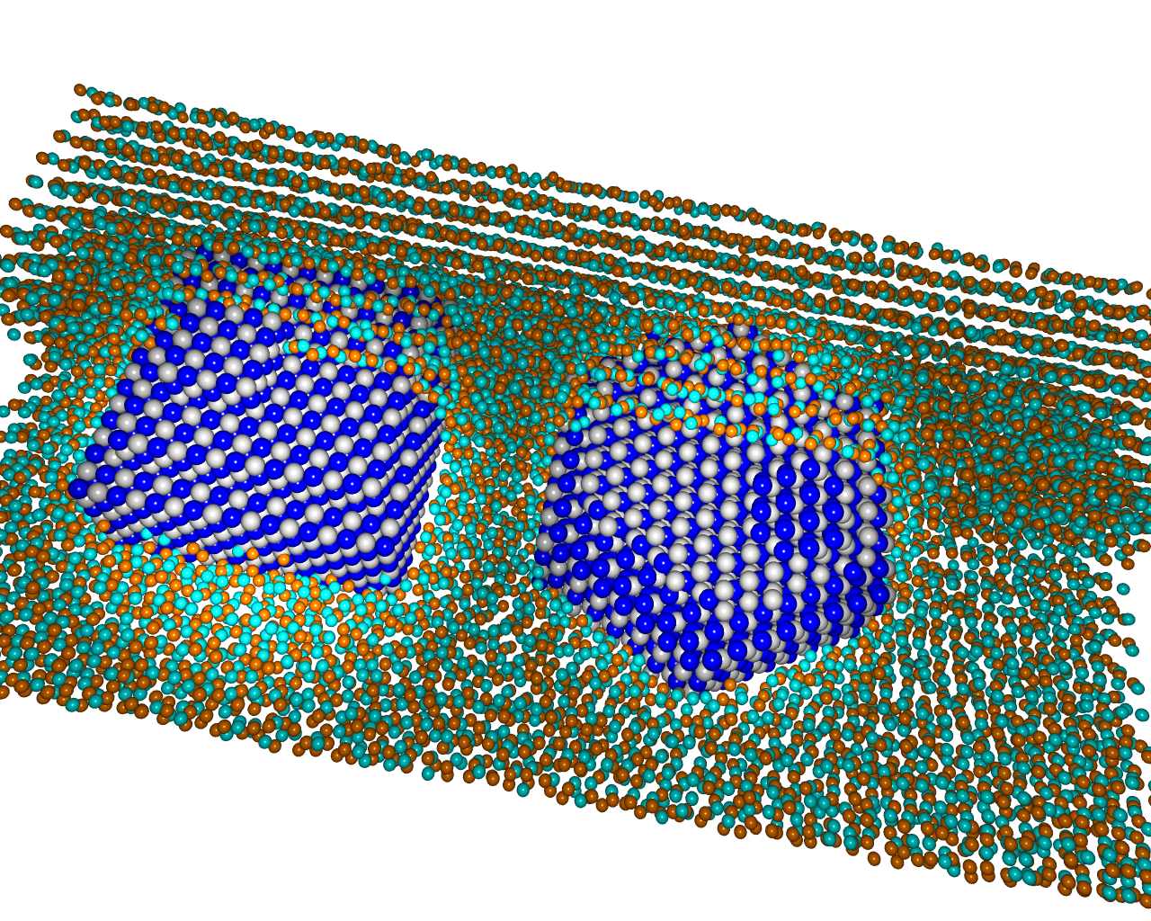
Playing with the lights…

